Slide 1

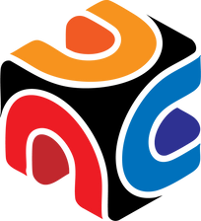
DEVHACK 2.0
ChronoSync
Hack your sleep,
not your alarm
AI-powered circadian rhythm optimization for students, professionals, and wellness enthusiasts
Notes:
1

Slide 2

DEVHACK 2.0
The Silent Epidemic
Circadian Misalignment
1+ Billion
Modern Causes
Serious Effects
People struggle with disrupted sleep-wake cycles worldwide
Blue light screens, irregular schedules, artificial lighting, jet lag
Chronic fatigue, poor focus, increased mental health risks
Notes:
2

Slide 3
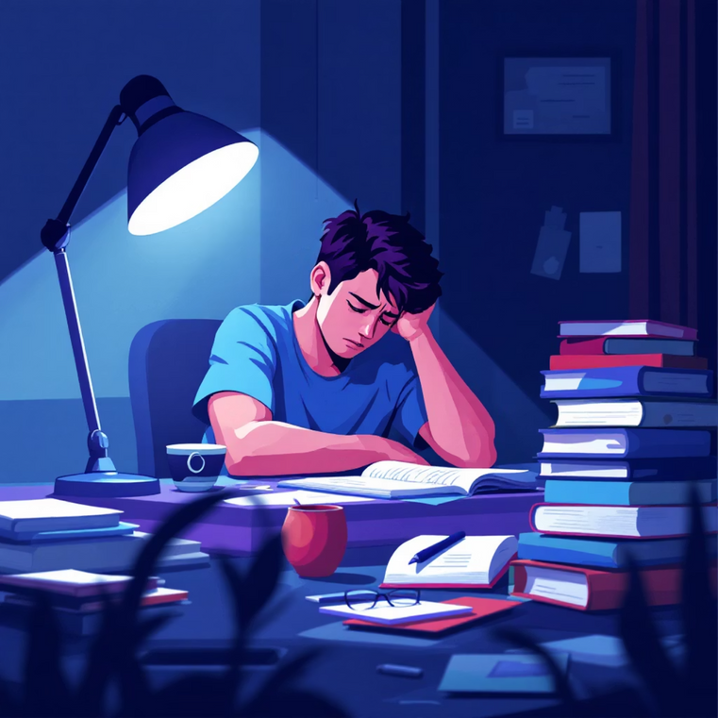
DEVHACK 2.0
Why Students & Workers Struggle
The Academic & Professional Crisis
Irregular class schedules and work demands destroy natural circadian rhythms, leading to a cascade of problems that impact performance and wellbeing.
Sleep deprivation linked to 20% lower academic performance
Irregular sleep schedules increase stress hormones by 40%
No affordable, personalized solutions exist for rhythm optimization
Notes:
3

Slide 4
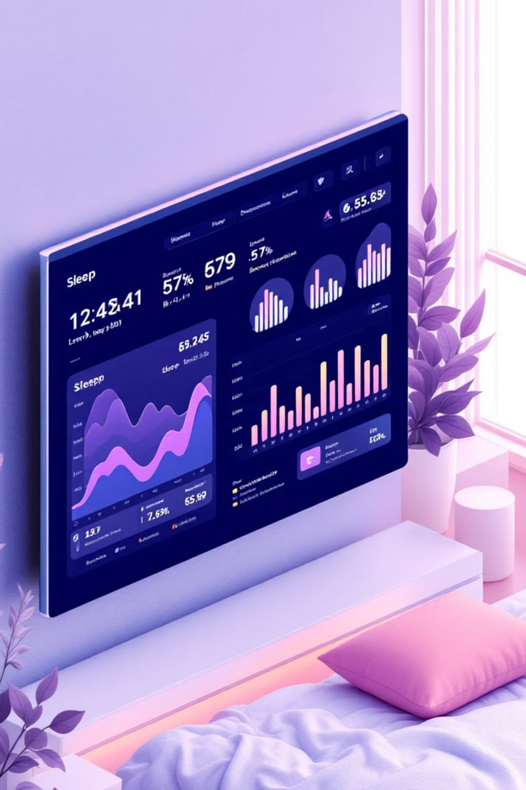
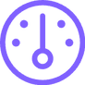


DEVHACK 2.0
ChronoSync
Your AI Body Clock Coach
Daily CRS Score
Circadian Rhythm Score tracks your alignment with natural sleep-wake patterns
Real-Time Recommendations
Personalized daily actions to optimize your circadian health and energy
Location Awareness
Real-time sunrise/sunset data for optimal light exposure timing
Notes:
4

Slide 5
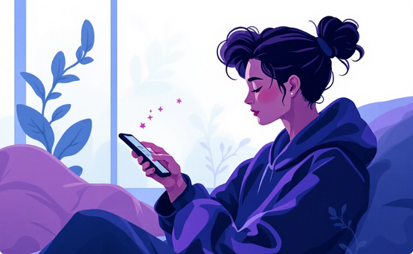

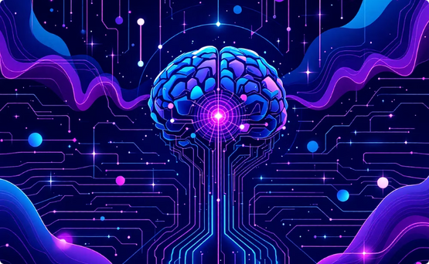
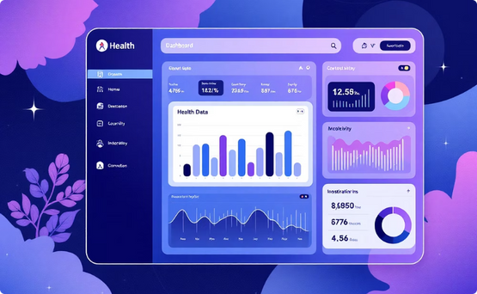
DEVHACK 2.0
How ChronoSync Works
Data Collection
Environmental Sync
AI Analysis
Visual Insights
Input sleep patterns, caffeine intake, screen time, and mood levels into the app.
The system fetches precise sunrise/sunset times for your location via Weather API.
Our AI engine calculates your personalized circadian rhythm alignment score.
An interactive dashboard provides clear trends and actionable recommendations.
Notes:
5

Slide 6

DEVHACK 2.0
Built With Modern Tech
1
2
Frontend Stack
Backend Services
Next.js + TypeScript + TailwindCSS for responsive, type-safe user interfaces
Firebase Authentication, Firestore database, and Analytics for scalable data management
3
4
External APIs
Data Visualization
Sunrise-Sunset.org and OpenWeatherMap for accurate environmental data
Chart.js and Recharts for interactive circadian rhythm tracking displays
Notes:
6

Slide 7
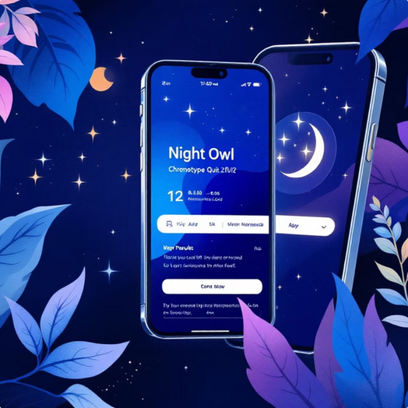
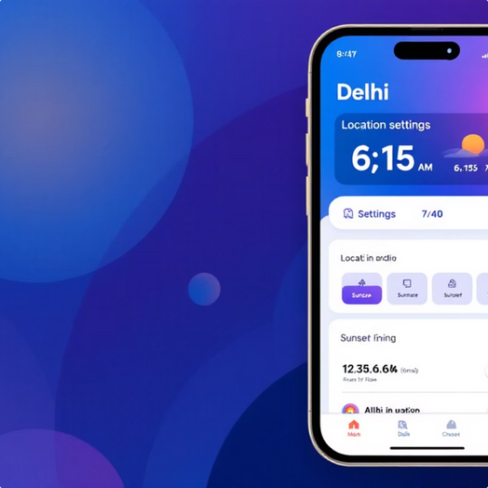
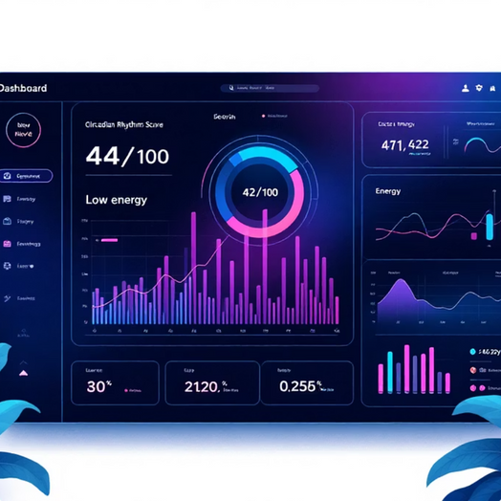
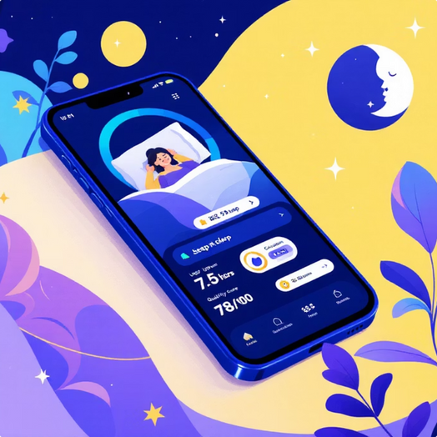
DEVHACK 2.0
Demo Experience
3-Minute User Journey
Onboarding & Assessment
Location Setup
Initial Score
Data Input Impact
User completes chronotype quiz, identified as "Night Owl" profile
Enters Delhi location → System displays Sunrise 6:15 AM, Sunset 7:40 PM
Dashboard loads showing Circadian Rhythm Score of 42/100
User logs 7.5 hours of quality sleep → CRS improves to 78/100
Adaptive Guidance
Tracking Progress
User views weekly trends, seeing consistent CRS improvement and better energy levels
Notes:
7

Slide 8
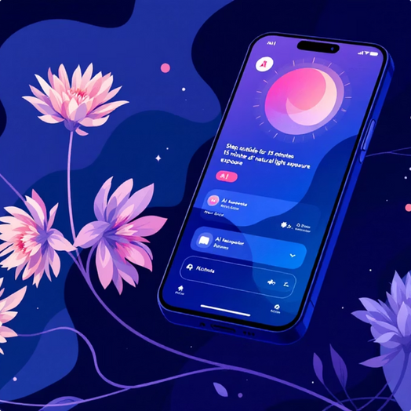
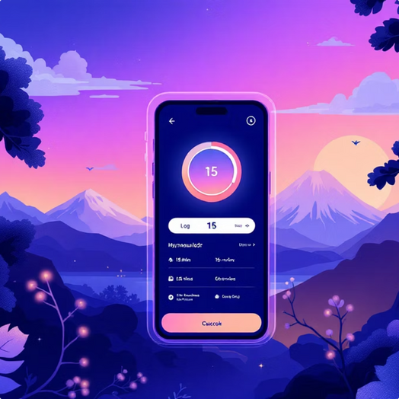
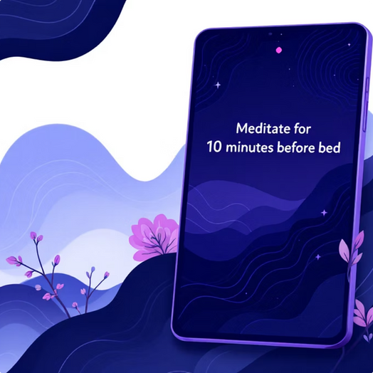
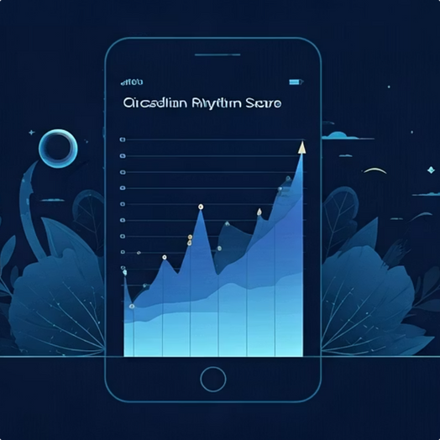
DEVHACK 2.0
Personalized Action
AI recommends: "Step outside for 15 minutes of natural light exposure"
Action & Logging
User steps outside as recommended, logs the light exposure in the app
Tracking Progress
User views weekly trends, seeing consistent CRS improvement and better energy levels
Adaptive Guidance
AI suggests: "Meditate for 10 minutes before bed" to counter potential disruption

Slide 9
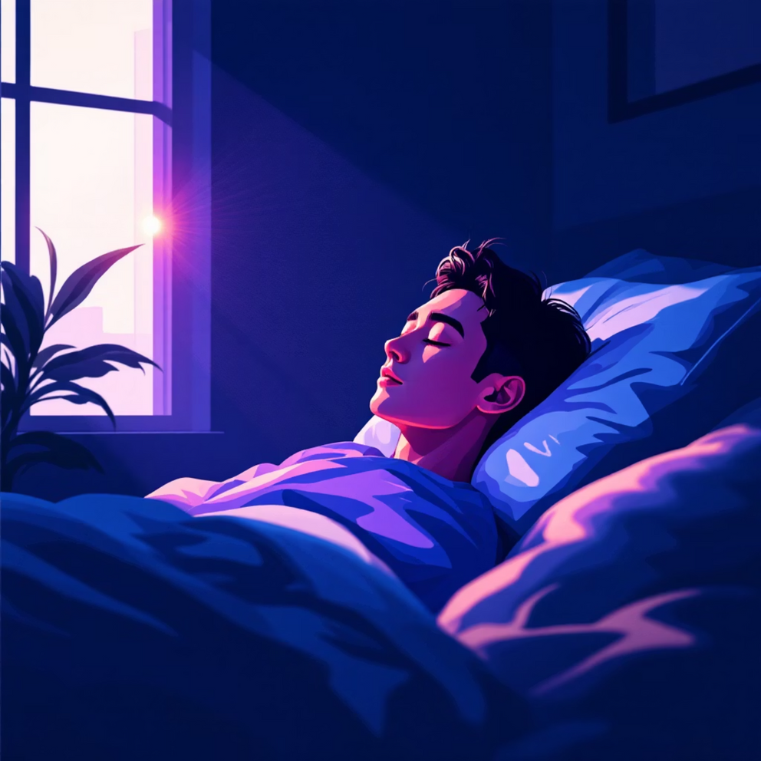
DEVHACK 2.0
Feasibility & Impact
Technical Feasibility
Achievable with Next.js, Firebase, and weather APIs
Progressive Web App enables cross-platform deployment
Scalable architecture supports thousands of users
Measurable Impact
Enhanced focus and cognitive performance
Reduced burnout and stress-related symptoms
Long-term lifestyle and health improvements
Notes:
8

Slide 10
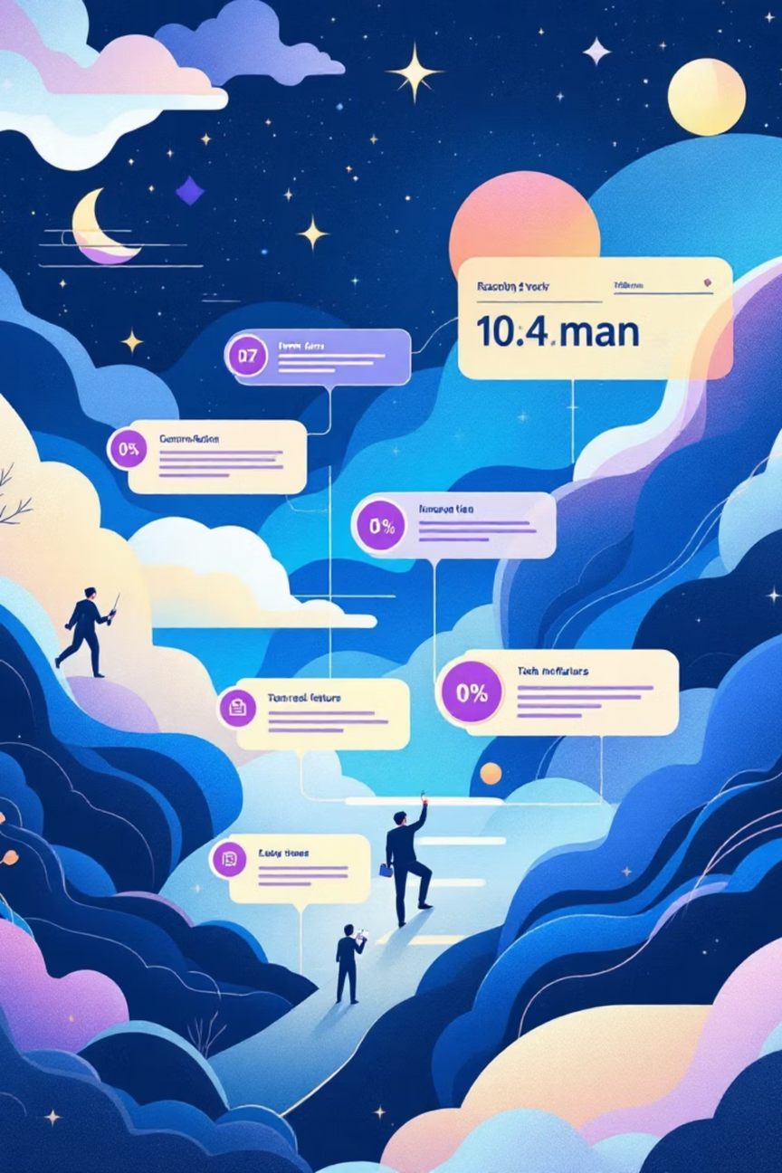
DEVHACK 2.0
Future Roadmap
1
Phase 1: Core Platform
CRS scoring system with personalized dashboard and recommendations. Addition of trophies and streaks for children to find the AI more interactive.
2
Phase 2: Wearable Integration
Seamless connection with Fitbit, Oura Ring, and Apple Watch devices
3
Phase 3: AI Coach + Enterprise
Advanced AI recommendations and corporate wellness program integration
4
Phase 4: Healthcare Expansion
Clinical partnerships and smart home automation for optimal sleep environments. Live one-on-one sessions with fitness experts.
Notes:
9

Slide 11
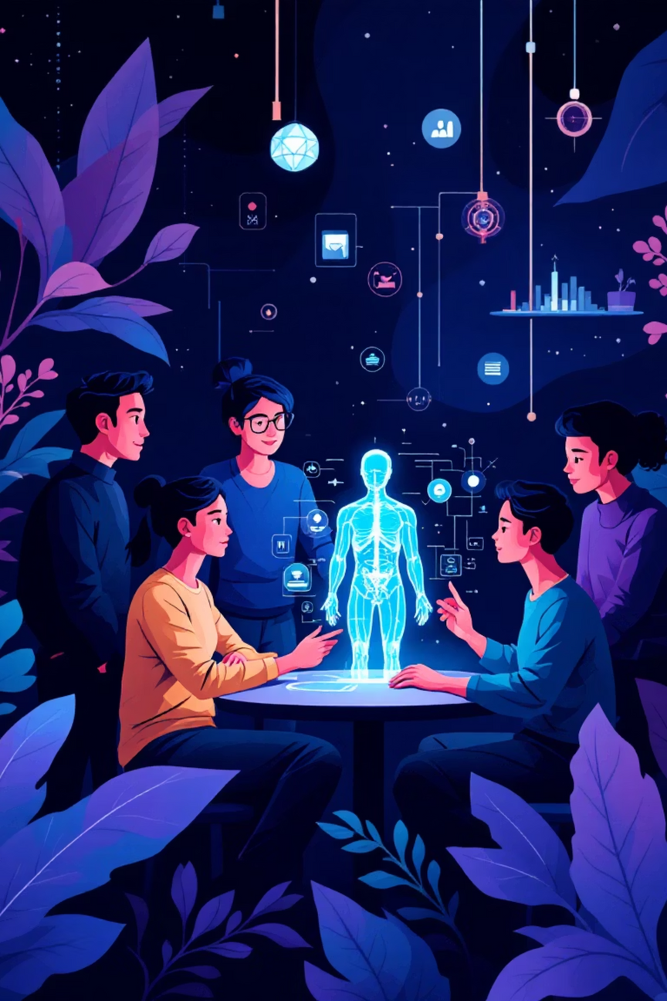

DEVHACK 2.0
Ready to Sync Your Success
Connect With Our Team
Join us in revolutionizing circadian health through innovative technology and personalized wellness solutions.
Project Leads: Pannagashree Alur
Sayoneel Dutta
Kushagra Kesharwani
Contact: pannaga.alur@gmail.com
sayoneeldutta1@gmail.com
kesharwani.kushagra@gmail.com
GitHub: https://github.com/Pannaga_004
https://github.com/Sayoneel
https://github.com/Kushagra026
Notes:
10

